Slide 1
Netflix Netflix and Social Responsibility
Noe Jimenez
Kevin Anaya
Fernando Esquivel

Slide 2
TABLE OF CONTENTS
Milestone 3
02
Milestone 4
03
Milestone 5
04
Milestone 6
Slides 4-7
Proposed IT project, Project Manager, SDLC
Slides 8-14
Project stakeholder, Project description, MOV, Project Scope, Scope management plan
Slides 15-23
Project Schedule, Project Budget Summary, Quality issues, Resources Required
Slides 24-30
Assumptions and Risks, Communication plan, Change of management plan, Human Resources, Implementation, and project closure plan

Slide 3
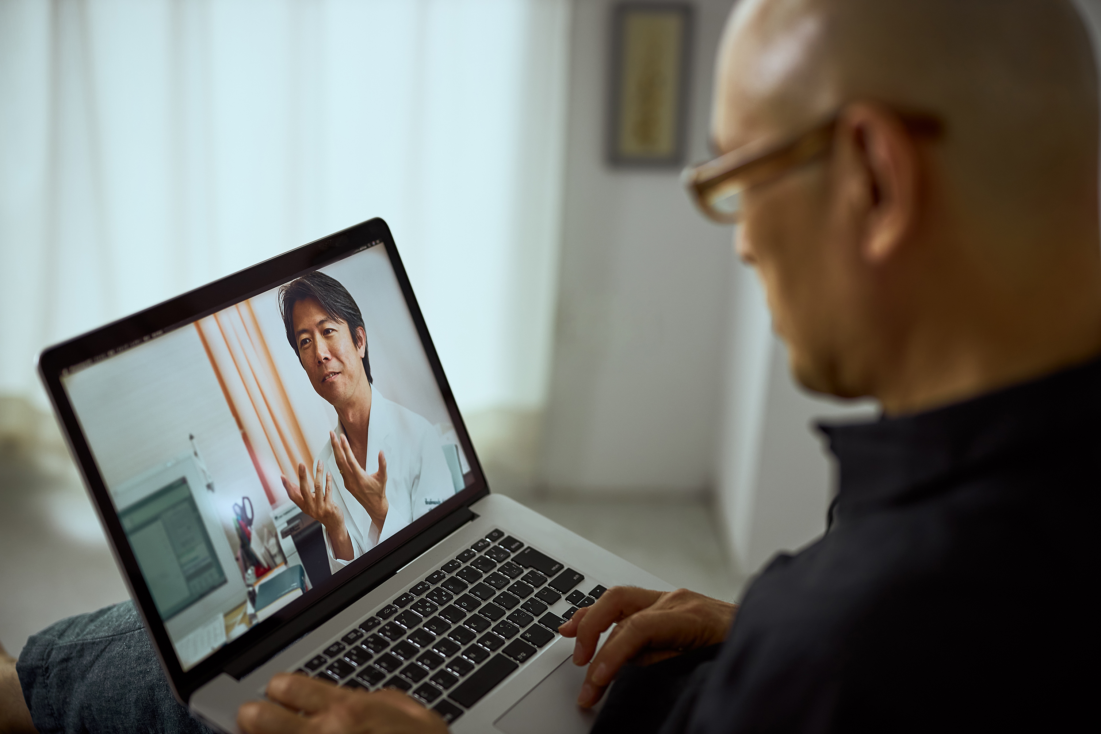
Proposal – Netflix Health
Netflix has an average watch time of 3.2 hours.
We propose a new implementation to Netflix called Netflix Health.
A Health system integrated to the already now working Netflix site.
It will implement licensed professionals to provide quick online physical and mental help.
Netflix will manage the Health records, Health Insurance, and Platform.

Slide 4

Project Manager Role and Responsibilities
Project Manager is required to have experience of 5-10 years to lead this project
In addition to their experience, they are required a bachelor's degree in Business Administration, Computer Information Systems, or related field.
Oversee major concurrent complex projects

Slide 5
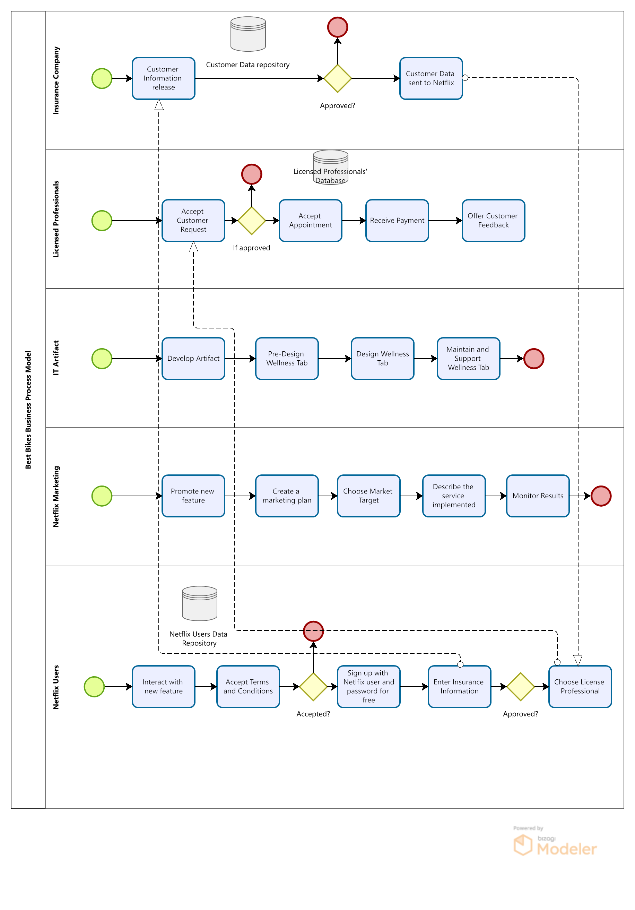
Netflix Business Process Model

Slide 6
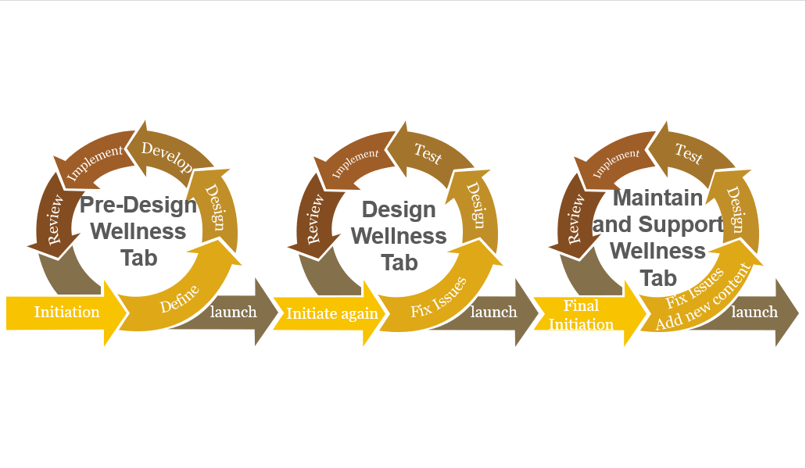
SDLC

Slide 7
SDLC
Pre-Design – In this stage, we will plan how our system is going to look like in order to enter the platform of Netflix. The qualifications that we need and the possible cons and pros of adding a new feature to Netflix.
Design - We will design how our tab will look during the design process. Our team will need to work together and collaborate during this time. The newly incorporated software must be capable of producing the desired results, and we must also pick how it will appear, as all Netflix primary tabs must seem comparable.
Development - The creation of the tab will take the longest because it will require a large amount of input to match the many criteria that we want to add to it. For example, we must find out how to accommodate consumers by adding their own insurance and selecting their own professionals. It is vital that we take our time during this phase since one small error might cause major issues for Netflix and the corresponding firms and experts who will be involved.

Slide 8
SDLC
Testing - Testing will take place with the introduction of the design-wellness tab. We will recruit testers for a beta app that will incorporate the newly developed functionality. We will also contact them for comments and evaluate any issues they may have encountered while using the program. The main goal of this is to guarantee that the software can function without major issues so that it may be updated and maintained.
Maintenance/Support - We will examine how effectively the system is functioning, as well as faults and potential modifications. To keep the system up to date, the new features will need to be updated on a regular basis. The new improvements will be available to all Netflix subscribers.

Slide 9
Project Stakeholders
Names | Title(s) | Phone Number | E-mail address
Kevin Anaya | Project Manager | 323-413-5293 | Kanaya8@calstatela.edu
Noe Arguera | Senior Software Engineer | 213-531-6740 | Njimen47@calstatela.edu
Fernando Esquivel | Software Engineer | 323-385-7869 | Fesquiv4@calstatela.edu
Jason Jewett | CIO (Project Sponsor) | 111-222-3333 | Jjewett@email.com
Deborah Black | Network Engineer | 111-222-3333 | Dblack@email.com
Reed Hastings | CO-CEO (Project Sponsor) | 111-222-3333 | Rhastings@email.com
Ted Sarandos | CO-CEO (Project Sponsor) | 111-222-3333 | Tsarandos@email.com
Spencer Neumann | CFO (Project Sponsor) | 111-222-3333 | Sneumann@email.com
Jocelyn Lopez | System analyst | 111-222-3333 | Jlopez@email.com
John Doe | Network Specialist | 111-222-3333 | Jdoe@email.com
Jane Doe | Customer Service Manager | 111-222-3333 | Jadoe@email.com
Dominique Jones | Software Developer | 111-222-3333 | Djones@email.com
Jeffery Williams | Software Engineer | 111-222-3333 | Jwilliams@email.com
Sergio Kitchens | Software Engineer | 111-222-3333 | Skithcens@email.com
Fox Mulder | Cyber security specialist | 111-222-3333 | Trust_No1@mail.com
Dana Scully | Software Developer | 111-222-3333 | Dscully@mail.cpm

Slide 10
Project Description
Description of the challenge or opportunity:
Our vision for this project is to show Netflix’s corporate social responsibility. Netflix accumulated around 190 million subscribers, all of which may require medical needs. With Netflix's current platform we are placing medical help within the homes of users and at their fingertips. Not only are we allowing direct access to medical attention, but we are opening Netflix to a wider audience.
Overview of the desired impact:
The desire for this project would be to have a system implemented into Netflix’s streaming platform that allows users to get into contact with medical professionals for mental and physical help within a matter of minutes all from a remote location.

Slide 11
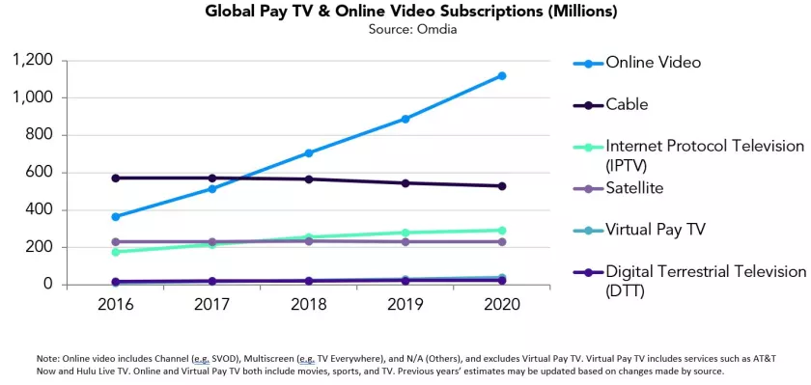
Note: Streaming milestone: Global subscriptions passed 1 billion last year. Los Angeles Times. Faughnder, R. (2021, March 18)

Slide 12
Measurable Organizational Value (MOV)
-The project will be successful if we work as a collaborative effort to bring this new concept to life. The goal of the project is to have easy access for customers to see a licensed professional for mental wellness needs. The mission is to provide care for all Netflix users that need someone to speak to at any given moment. Many people have never seen a licensed professional because many feel they do not need it or have no time. But with an application as popular as Netflix, that can be very possible with a click of a button. The goal would be an increase of 30 million users and expect an extra 90 million in revenue for the first quarter of the launch. The quarter that this project will be launching will be Q4 of the fiscal year of 2024. Success will be achieved when at least one user provides positive feedback on a session with a licensed professional. The value that this project will bring is a lifelong lesson that counseling provides.

Slide 13
Project Scope
Inside the project scope
-Pre-design and Design the wellness tab and its features
-Developing the wellness tab Software maintenance will be included in our scope
Outside the project scope
-Netflix will not have its own licensed specialists; instead, they will require contracts outside of the project
-Medical firms are likewise outside of the scope of our project unless they contact us

Slide 14
Scope Management plan
Project Scope Description: The project will include the creation of a health tab for all Netflix-enabled devices, which might include smartphones, computers, and streaming media players. This application will be capable of assisting those who desire to seek mental health assistance but do not know how. Access to this new tab guarantees the user the greatest possible assistance from medical specialists who will be available whenever they need it.
Project Deliverables - Within our project, the project deliverables will be divided into many categories. Among these are our pre-design, design, and execution areas. We will provide a model of how the program might look if it were to be implemented. Our team will present this concept to the Netflix company's stakeholders.

Slide 15
Scope Management Plan
Project Acceptance Criteria - To make this project a success, we need to see an increase in users of 30 million and revenue of 90 million dollars in the first quarter. A minimum satisfactory target of more than 1 million evaluations from pleased consumers would also be required.
Project Exclusions - The medical specialists and medical corporations will not be involved in the initial phase. To be a part of this project, they must be able to sign a contract or reach an arrangement with Netflix.
Project Limitations - Because the development of the new tab will take time, stakeholder satisfaction may become our most critical restriction. Another limitation that we may face is the number of elements that may be included in the wellness tab. Furthermore, the material created should comply with the Netflix company's ideals.

Slide 16
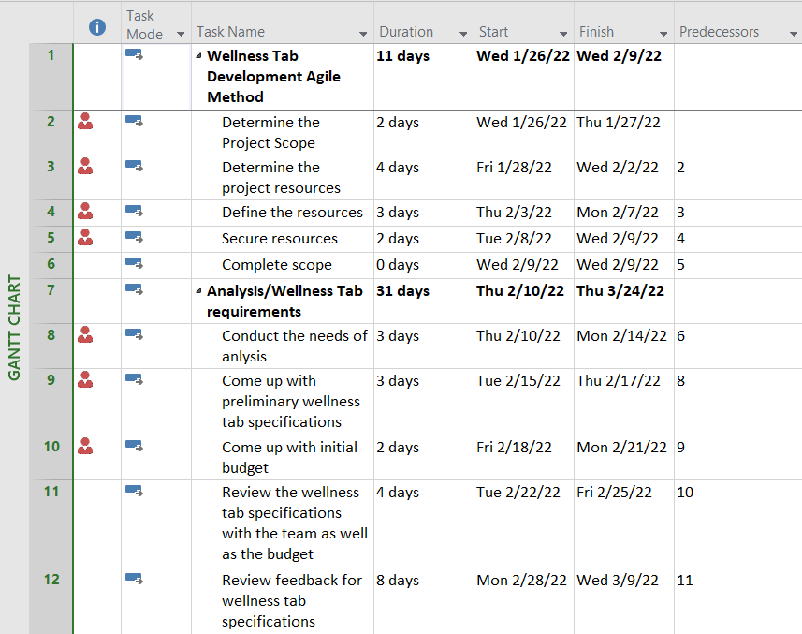
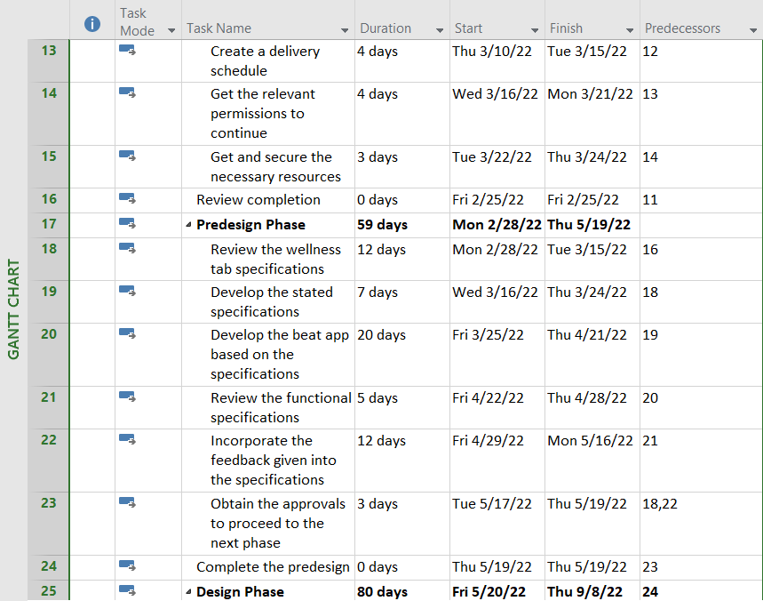
Project Schedule

Slide 17
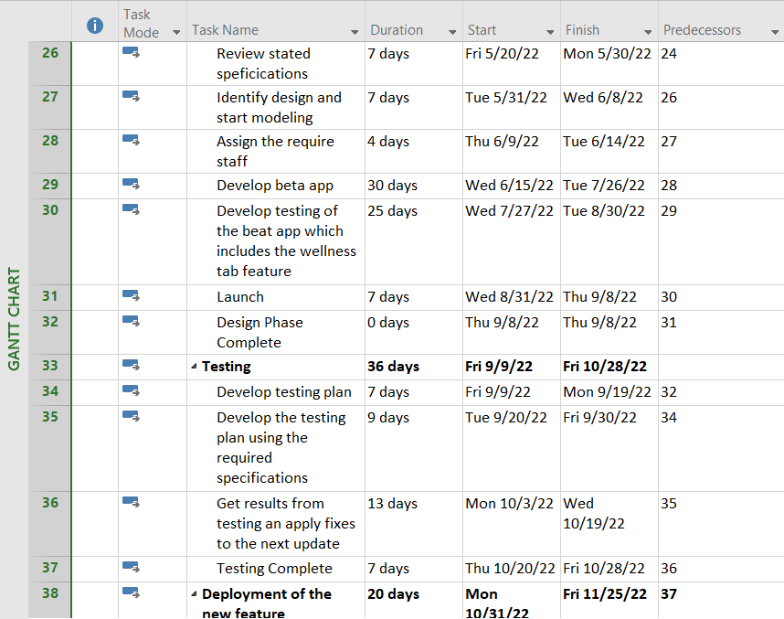
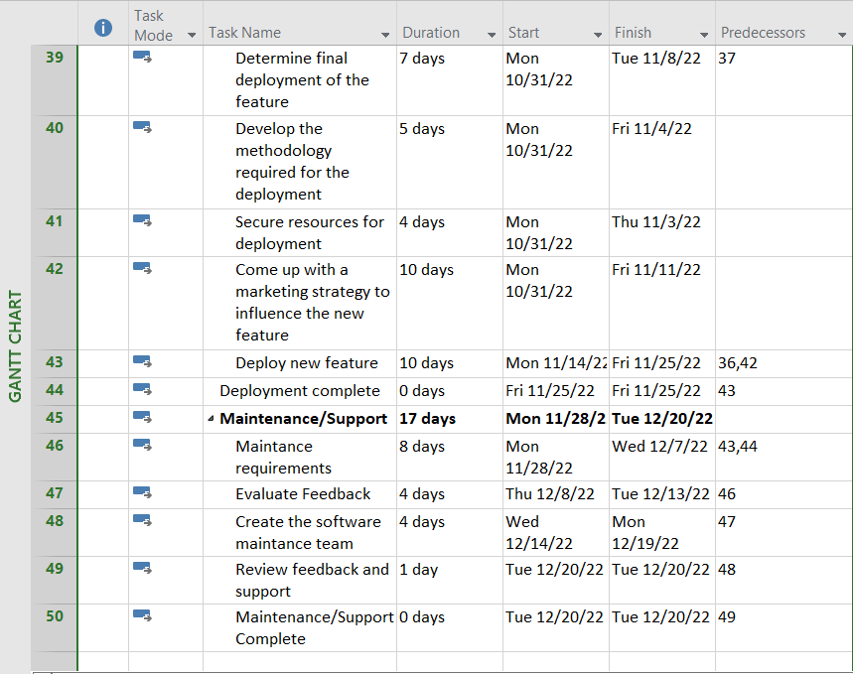
Project Schedule

Slide 18
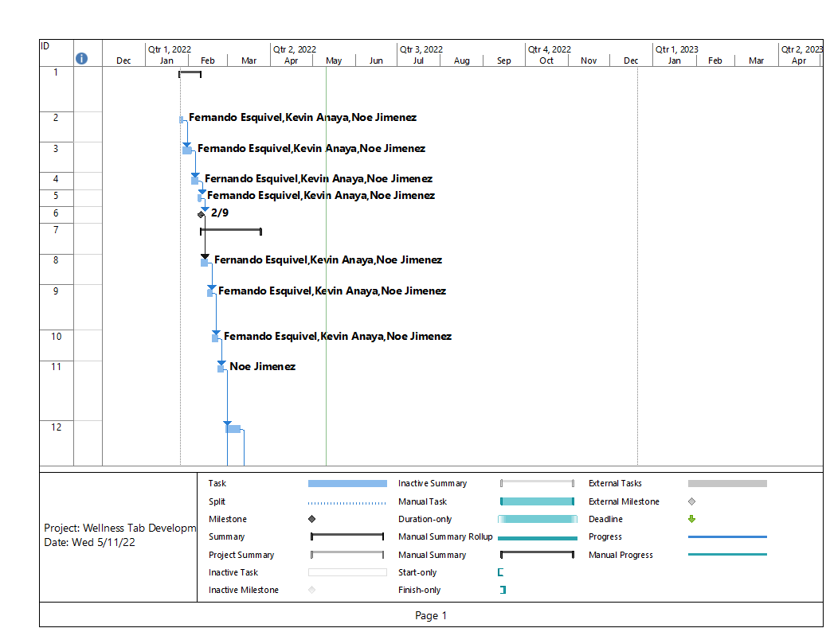
Project Gantt Chart

Slide 19
Resources Required
- When planning the construction of our product we must consider all possible resources we may require. For this project, we will be using assets mainly from Netflix for the design, development, and analysis of the Netflix Health program. Due to the scale of the proposed project around 21 employees will be needed for the design and development. These employees will come from different departments within the company for the product's development. With, the 21 employees designated will all need their own suite of software and tools necessary to complete their work (such as computers, and software licenses).

Slide 20
Resources Required
Needed Personnel:
1 Project Manager
1 Senior Software Engineer
1 Software Engineer
1 Network Engineer
1 Systems Analyst
1 Network Specialist
2 Software Developers
1 Software Engineer
12 Team members
Technology Required:​
Software: Java, MySQL Computers that have high capabilities and with the latest hardware installed and fully updated A facility where it can be designed and tested​

Slide 21
Resources
Resources
Resource Requirements | Cost
Staffing | · 1 Project Manager · 1 Senior Software Engineer · 1 Software Engineer · 1 Network Engineer · 1 Systems Analyst · 1 Network Specialist · 2 Software Developers · 1 Software Engineer · 12 Team members
Software/Hardware | Java, MySQL 13 Laptops 1 Workstation

Slide 22
Resources Required
Facilities | Main Facility · In here the team will be developing, testing, and launching the app’s feature
Misc. | Office Supplies that might be needed such as: · Paper · Printers · Pencils · Etc.

Slide 23
Project Budget Summary
Total project budget
This project will have a budget of $3 million and an execution period of 8 months. Our budget will mostly consist of wages and resources used to establish Netflix's health tab. Our budget will be presented in the table below, with the amount for each Phase underlined. There will be six phases to complete, each with its own time frame and staffing requirements. We intend to recruit a total of 13 individuals; however, some stages may not need particular personnel, enabling to save more money on staff costs and redirect those funds to research and innovation.
Budget Broken Down by Phase

Slide 24
Project Budget Summary
Project Manager = $91,000
Senior Software Engineer = $110,000
1 Software Engineer = $78,000
1 Network Engineer = $68,000
1 Systems Analyst = $47,000
1 Network Specialist = $74,000
2 Software Developers = $150,000
1 Software Engineer = $54,000
12 Team members = $97,200
MySQL, Java = $80,000​
Office Supplies = $10,000​
Rental facility per year = 160,000​
Total = $1,019,200​
Monthly = 127,400​
Total project length = 270 days

Slide 25
Quality issues
Project Name:
Netflix Health
Quality Standards:
-Focuses on the IT artifact and how the project's quality will be controlled throughout the project's lifespan.
-Prevention will assist in detecting problems before they occur to avoid mistakes and assist the team in resolving them.
-The system must perform well for customers to be satisfied.
Quality Issues:
-Specify quality requirements.
-IT artifact must be consistent.
-Application errors like glitches and bugs.
-IT artifacts must be performed and maintained regularly.

Slide 26
Quality issues
Metrics:
-Surveys from consumers will not only allow real-time feedback but give us a chance to correct any issues that may arise. The surveys will also allow for constant improvement of the product and different iterations to continue to build/improve.
Problem Reporting and Corrective Action Process:
-All reports will be sent to the Software engineer team to solve bugs/glitches with the new system.
Supplier Quality and Control
-Each licensed professional will be interviewed and reviewed before getting access to clients.
Credential reviews such as degree/certificates and experience.

Slide 27
Assumptions and Risks
Assumptions used to develop estimates
-Project team members and all staff are required to complete this project.
-Funds needed to support the project, from investors.
-Timeline on the project given, to be completed by Q4 of the fiscal year of 2024.
Keeping Budget control | Not likely | Will upset investors if the project goes over budget.
Low user count | Not likely | It will be a new concept and will be brand new for some users to experience.
Timeline inaccurately depicted | Likely | Most expected cause delays in release and updates.

Slide 28
Communication plan
-The communications strategy will specify who needs to be aware of and informed about the project, how and how frequently information will be disseminated, and who will oversee disseminating it. This will aid in the facilitation of effective communication between our staff and project stakeholders.

Slide 29
Change in management plan
-The key to successful organizational change is to plan for and manage the change and the associated transition effectively. This entails developing a change management plan that addresses the human side of change.
Sponsor— Chief Information Officer approve any major changing factors to the project's implementation as they manage the budgets and resources of the department.
Change Agents— The project management group, the executive board, the chief information officer, and shareholders.
Targets— consumer/customer and the developer team
Stakeholders | Communication Name | Delivery Method/Format | Producer | Due/Frequency
Executive Committee (Sponsor) | Monthly Status Report | Meeting and Formal report | Project Manager | 1st day of every Month
Project Team | Weekly Status Reports | Meeting | Software Developers and Team | Monday Mornings at 10:30am
Project Management | Weekly Status Reports | Meeting and Formal Report | Software Developers and Team | Monday Mornings at 11:00am
Employees | Important Announcements | Email and Department memo | Project Manager | As needed

Slide 30
Human resource plan
-All project team members must meet the best role suited for the completion of the project. In this requirement all departments working on this project's overall goal must align in its completion.
-All team members in their ability must be able to complete daily tasks regarding the project's completion in a moderate and well-rounded manner.

Slide 31
Implementation and project closure plan
-Individual performance reviews will be performed by respective supervisors.
-Team close-out meetings will be held by project leads and our personnel overseas the projects direction (Project Manager, CIO).
-Project audit Project audit can be performed by the project management team. -
Evaluation of projects MOV Project’s MOV or measurable organizational value will be evaluated by the executive committee as well as the CIO.

Slide 32
Summary of the Project
The proposed project is a mental wellness tab added to Netflix. The goal is to provide professional care to Netflix subscribers at the comfort of their own home. Our main objectives are to add a new feature to the Netflix app as well as helping its users who might be going through difficult times.
The project will consist of 20 team members creating this project. The project will be monitor by the project management team. The project is about a year worth of creating and will take time to launch.

Slide 33
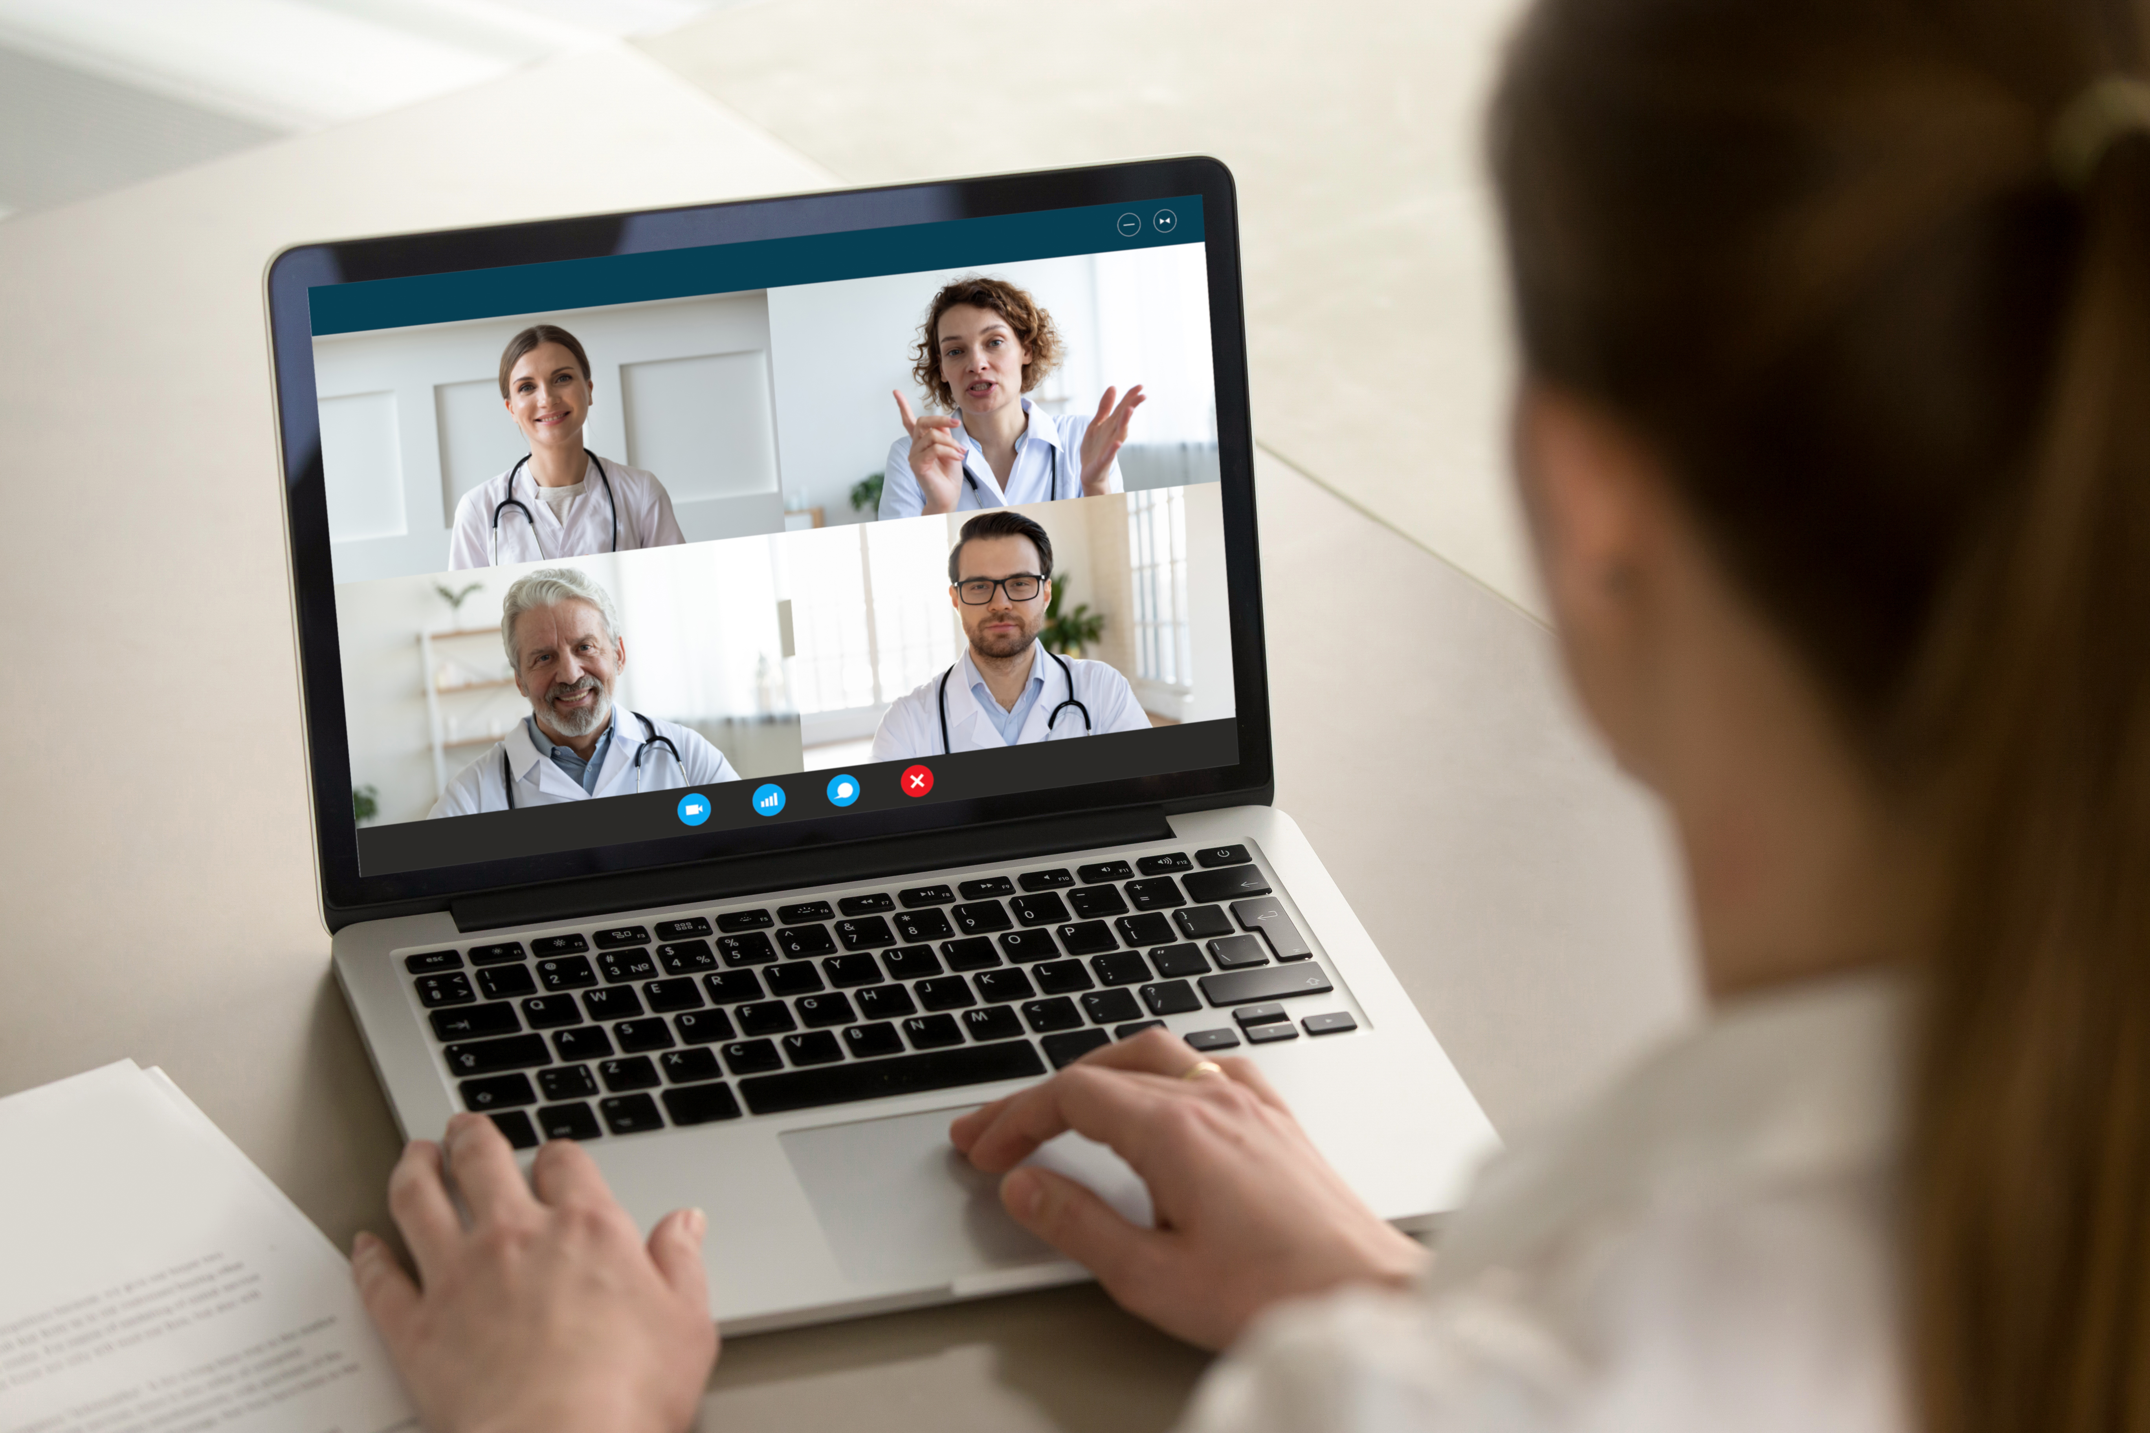
The End

